Slide 1
360° Vision Sensors for Land Vehicles
CLASSIFICATION
What can VR technology bring to modern Land Vehicles?
Notes:
One of the research areas within Advanced Vehicle Systems is into the improvement of vehicle sensors. To this end, we have been focusing on emergent technologies such as 360 degree video and Virtual Reality as potential additions to our Land Vehicles.
So, what can 360 degree video and VR bring to our next generation land vehicles?

Slide 2
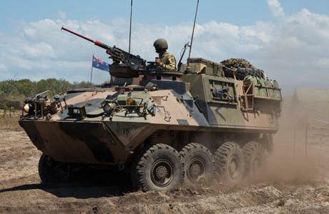
Situational Awareness vs Safety
CLASSIFICATION
Current trade-off:
Awareness
Safety
Situational Awareness: The perception of events in the environment and the ability to predict their future states
Notes:
To answer that, we need to understand the value of situational awareness and safety.
When on deployment, situational awareness is what keeps our soldiers alive. Being able to accurately assess a situation, identify potential threats in the environment, and act appropriately. This capability is vital as without it, the lives of our servicemen and women are put at risk.
This becomes a problem when awareness is limited in order to provide adequate protection. For example, the M113 Armoured Personnel Carrier is often operated with hatches open to allow operators a greater field of view. This exposes the personnel to enemy fire. In dangerous situations, the hatches go down, and the vehicle is then operated using a restricted field of view using external cameras or view ports. In this scenario, the vehicle now is less capable of making tactical decisions, reducing its effectiveness on deployment.

Slide 3
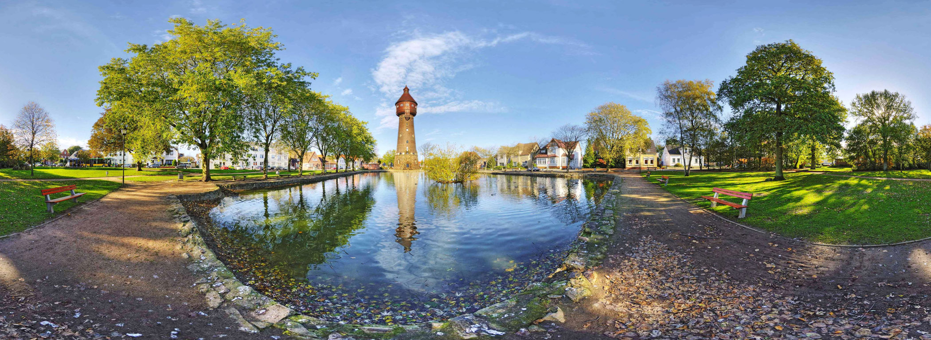
How can 360° Cameras Help?
CLASSIFICATION
Provides video input of all surroundings
Imitates the FOV an operator would have outside the vehicle
Notes:
A solution to this problem is the use of a 360 degree camera system. This uses an array of wide angle cameras on a single device to record footage from any direction. These images can then be stitched together to make a panoramic view of the camera’s surroundings.
While technically providing vision to all points around the vehicle, this is somewhat difficult to utilise this video as a 2 dimensional image. The image is warped due to the panoramic view and it is sometimes difficult to get accurate information about the environment quickly and easily.

Slide 4
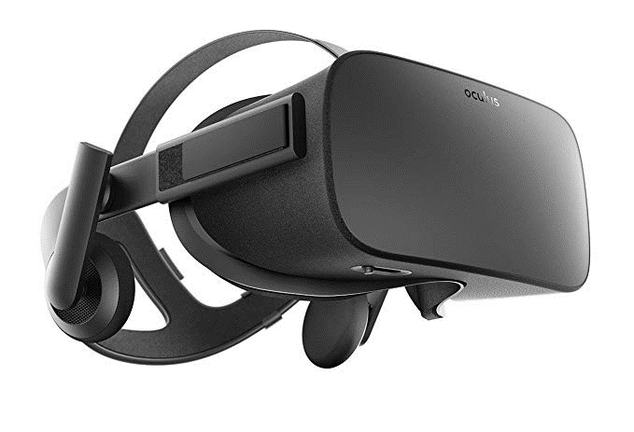
VR Headsets
CLASSIFICATION
Makes panoramic images from 360° cameras usable
Provides next best alternative to being outside the vehicle
Notes:
This is where a Virtual Reality headset, such as the Oculus Rift comes in.
Combined with a VR headset, the 360 degree camera allows operators the same field of view as if they were outside the vehicle. The panorama from before can be viewed in a much more immersive and intuitive manner, which therefore allows personnel to focus on completing other tasks effectively.
With this capability, personnel now have near equivalent situational awareness from within the vehicle, without compromising the safety of the operators. This could be useful for a range of vehicles as a way to increase combat effectiveness in situations where operators need to remain inside the vehicle.

Slide 5
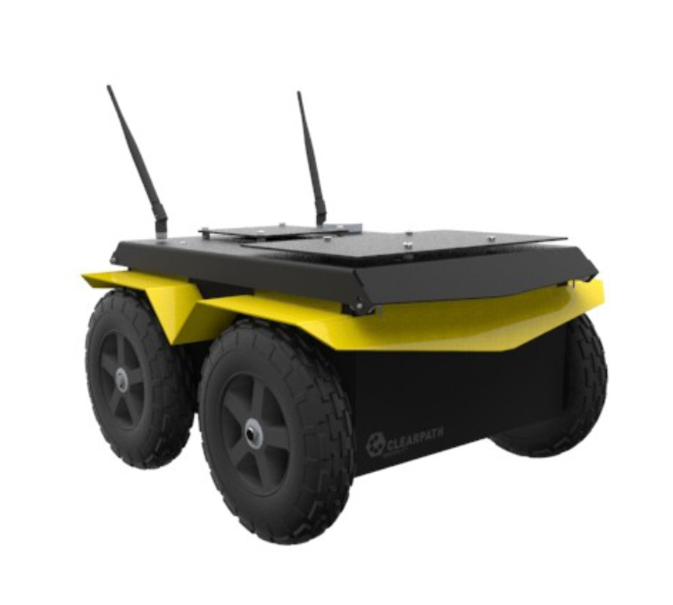
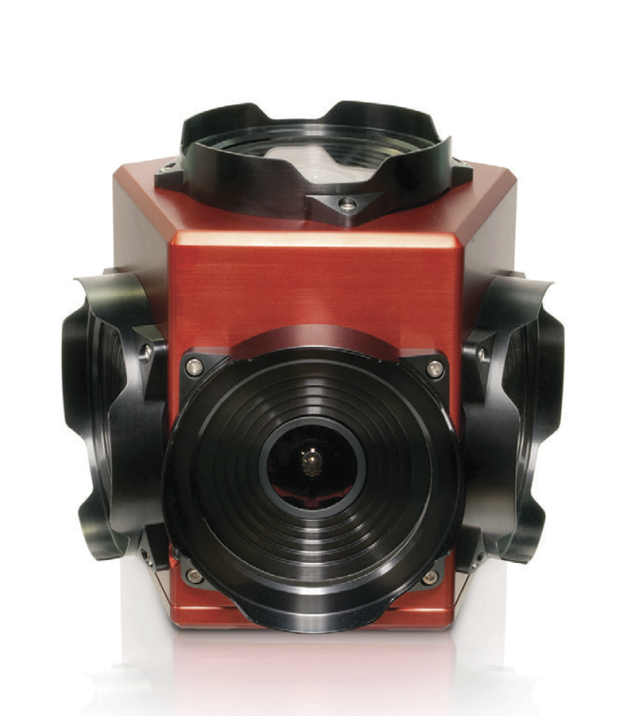
Implementation
CLASSIFICATION
Notes:
For this project, we wanted to implement a basic version of this technology using a Jackal UGV as a testing platform. The aim was to install a 360 degree camera onboard the robot and stream the video to another PC. Put simply, we wanted to put that camera on the Jackal UGV as a proof of concept.

Slide 6
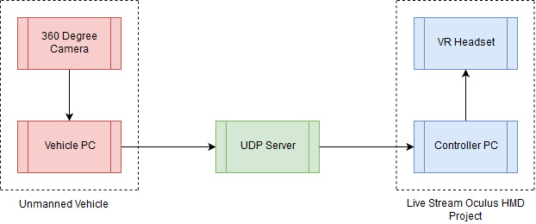
Design Architecture
CLASSIFICATION
Notes:
Here you can see the rough architecture we used for this project. I was responsible for developing the hardware and software on the left side of the diagram, in particular the camera interface. Next we had to find a method to packetize and send the images recorded by the camera via UDP to be used by the Live Stream Oculus HMD Project being completed by Harvey Prom.

Slide 7
Results
CLASSIFICATION
Functional Camera software interface
Rudimentary data streaming via UDP
Identified limitations within Defence Standard DS 00-82 for implementing 360° video
Ladybug5+ unsuitable for use on UGV’s
Notes:
From this project, we’ve successfully developed a software interface between the camera and other devices. We have also been able to implement basic data streaming via UDP, however this is limited by available bandwidth and the constraints imposed by DS 00-82. Right now we are aiming to be able to continue working on this project into its next phase of development as part of LOAVES.

Slide 8
Recommendations
Better suited for larger vehicles
Hard wired PC based solution

